Slide 1
Statistical Causal Inference
Tyler Tuan
Brief overview of first 3 parts of the book:
Causal Inference by Rubin and Imbens

Slide 2
Overview
Brief general overview of the book
Counter-factual and Potential Outcome
Assignment Mechanism
Randomized
Design
Instrumental Variable
Inference
Individual Causality (imputation/missing)
Population Causality
Randomized: classical vs model-based
Design: propensity based

Slide 3
Counterfactual Potential Outcome
Counterfactual: What would happen if otherwise?
Actions: 0 or 1
Potential Outcomes: Y(0) and Y(1), both R.V.
If W is the action taken
Y(W) is observed outcome
Y(1-W) is the counter-factual outcome
Why this definition?
The signal of Y(W) doesn’t imply W(Y)
There is a clear sign of directionality of causality

Slide 4
Causality
Y(W) – Y(1-W)
In this language, we can express:
Individual causality: Y_{i}(W_{i}) – Y_{i}(1-W_{i})
Population causality: sum(Y_{i}(W_{i}) – Y_{i}(1-W_{i}))
Problem of missing value:
Y_{i}^{obs} = Y_{i}(W_{i})
Y_{i}^{miss} = Y_{i}(1-W_{i})
Inference is imputation (individual or population-wise)

Slide 5
Mechanism Assignment
Assignment Mechanism: how did individual i^{th} come take action W_{i}?
Do researchers have control over this assignment?
Control: know exactly what affect action W_{i} to happen
Do researchers know about the assignment process?
This rely on pre-action covariates X_{i}
Types:
Randomized: completely in control
Design (observational): not in control and assignment can be inferred
Instrumental variable: partially control
Example: effect of lunch on end-of-day blood pressure
time of lunch
fat (hi – low)

Slide 6
Recap
W: action taken
Outcomes:
Y(W) observed
Y(1-W) counter-factual
X: pre-action covariates
Assignment Mechanism:
p(W|X,Y(0),Y(1))
Or p(W|X) for simplicity
Propensity score: e(X) = p(W|X)
Causality: Y_{i}(W_{i}) – Y_{i}(1-W_{i})

Slide 7
Inference for Randomized Experiment
Infer: Y_{i}(W_{i}) – Y_{i}(1-W_{i}) or | Y_{i}^{obs} - Y_{i}^{miss}|
Assignment Mechanism for W_{i}: with complete control over the assignment
Bernoulli trials: pure random assignment
Completely randomized exp: N_{t} out of N
Stratified randomized exp: assign by X_{i}
Inference:
Fisher: exact hypothesis Y_{i}(1) = Y_{i}(0) for all i → test statistics & confidence interval
Neyman: average treatment effect Y_{ave}(1) = Y_{ave}(0)
Regression
Taking X_{i} into account
Y_{i}^{obs} = a + bX_{i} + cW_{i} + e_{i}
Model-based imputation: infer f(Y^{miss}|Y^{obs}, W)

Slide 8
Inference for Observational Studies
W_{i} is not assigned by researchers. The subject takes action along with observational covariates X_{i}.
Stratification: adjust for confounders
Improve the idea of stratification
Balancing score: reduce dimension for stratification
Propensity score e(X) = p(W|X) is balancing score
Treat as Bernoulli trial given propensity score
Estimate (4 approaches):
Imputation: Y^{miss}|Y^{obs}, X, W
Weighting: E[Y_{i}^{obs}W_{i}/e(X_{i})] = E[Y_{i}(1)]
Stratification: create blocks of similar propensity
Matching estimators

Slide 9
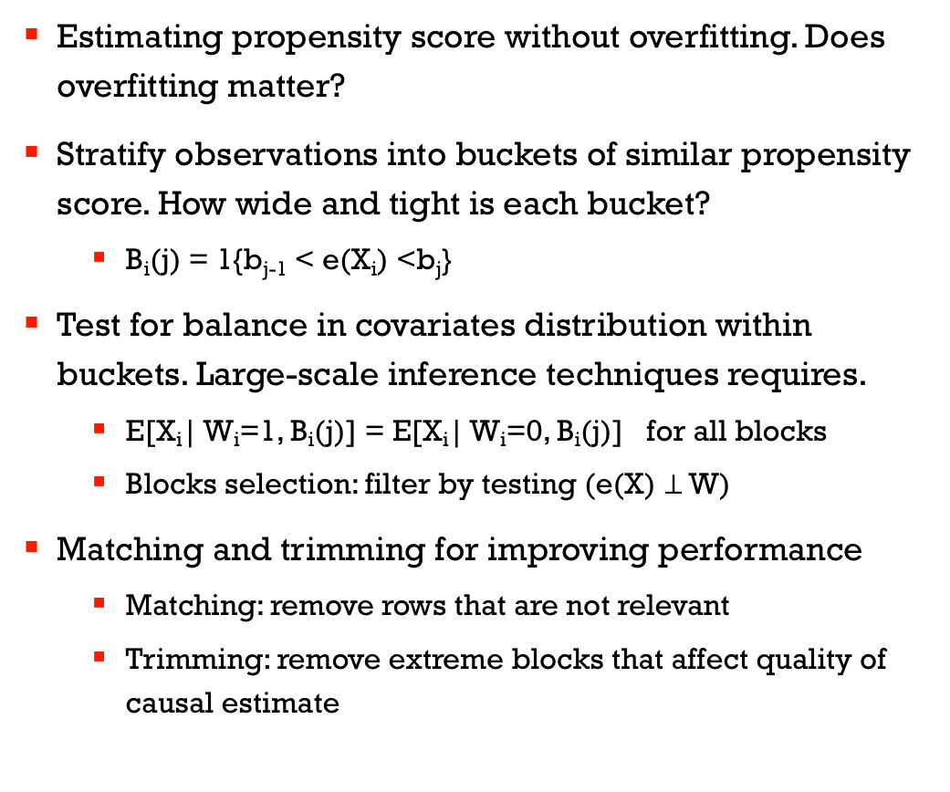
Real Work
Estimating propensity score without overfitting. Does overfitting matter?
Stratify observations into buckets of similar propensity score. How wide and tight is each bucket?
B_{i}(j) = 1{b_{j-1} < e(X_{i}) <b_{j}}
Test for balance in covariates distribution within buckets. Large-scale inference techniques requires.
E[X_{i}| W_{i}=1, B_{i}(j)] = E[X_{i}| W_{i}=0, B_{i}(j)] for all blocks
Blocks selection: filter by testing (e(X) $⊥$ W)
Matching and trimming for improving performance
Matching: remove rows that are not relevant
Trimming: remove extreme blocks that affect quality of causal estimate

Slide 10
Further topics
Applications
Causal network
Directionality
Feed-back loop
Robustness

Slide 11
Possible next topics
Assess the estimation of
propensity score
balance in bucketing
Continuous variable: http://www.math.mcgill.ca/dstephens/SISCR2017/Articles/HIrano-Imbens-2004.pdf
Causal performance evaluation
Simulated ground truth
Robustness in real data

